Slide 1
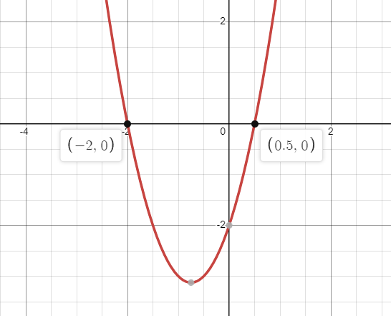
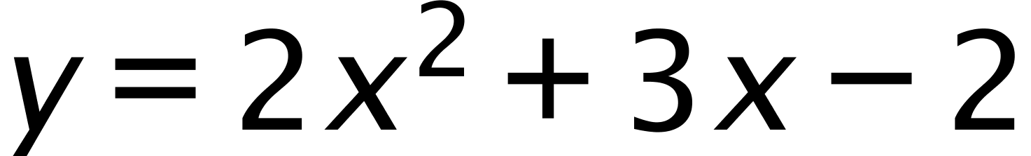

The Dreaded Quadratic Equation
This equation
looks like this
when graphed
Noticed the x intercepts
of -2 and 0.5
The formula has the following coefficients:
a = 2 b = 3 c = -2
If we plug these values into the quadratic formula,
we will get the result of -2 and 0.5

Slide 2
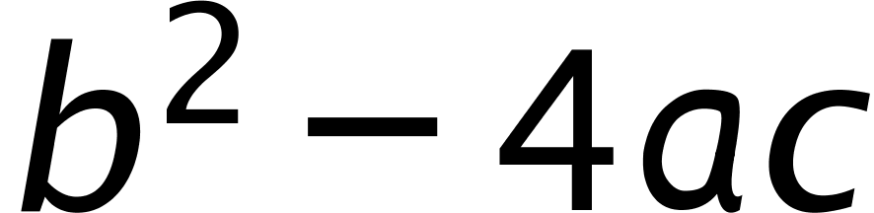
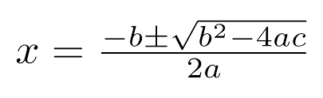
Let’s write a program to calculate the x intercepts for us.
This is a lot of calculating so we will take this and break it into multiple steps:
Calculate the result of
and assign the result to a variable we’ll call underRoot(because it's under the square root sign)
underRoot = math.pow(b, exp)-(4*a*c)
2. Calculate the square root of the terms under the
square root sign(underRoot) and assign the result
to a variable we’ll call root.
5. Calculate the value of 2 x a
assign the result to a variable
we’ll denom.
root = math.sqrt(underRoot)
denom = 2 * a
3. Take the value of –b and add it to the value of root, assign this result
to a variable we’ll call posNumer
posNumer = -b + root
4. Take the value of –b and subtract the value of root, assign this result
to a variable we’ll call negNumer
negNumer = -b - root

Slide 3
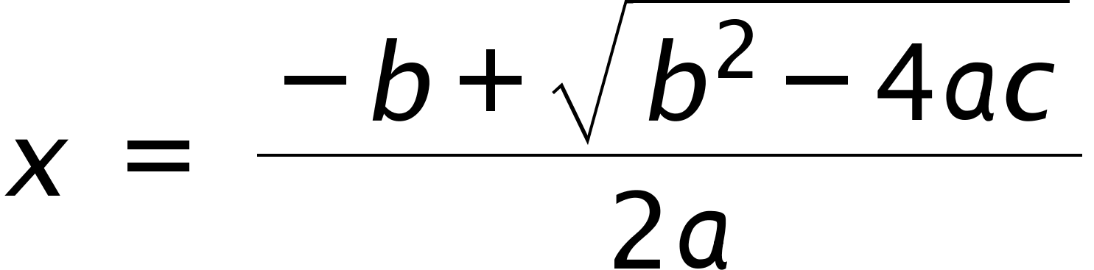
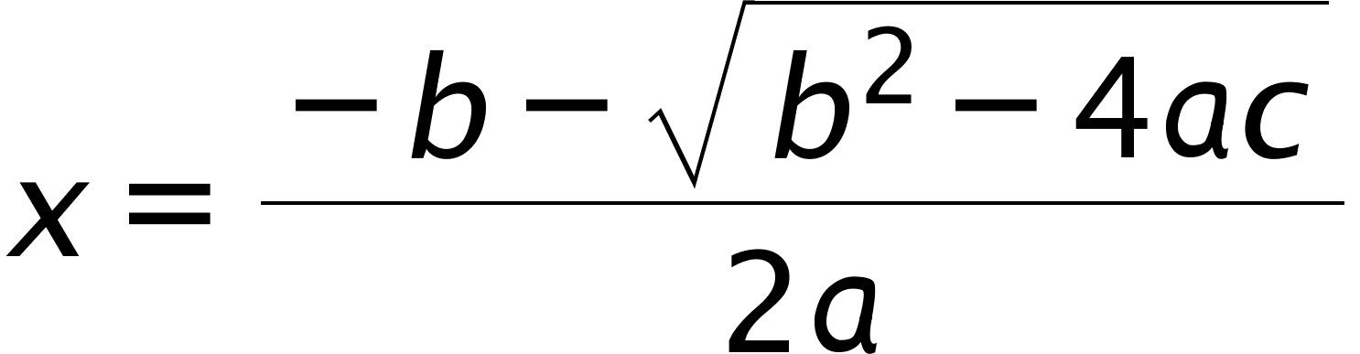
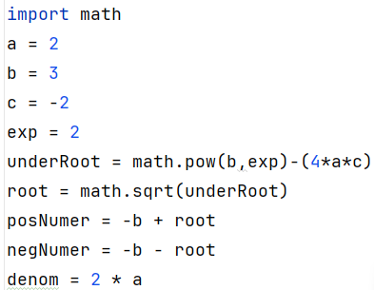
actually, represents two formulas…
AND
1
2
… so we will take all the information we have so far and calculate two different values,
one for each of the two above formulas.
Also, when creating such a complex program, it can be useful to use known values(values to which we know the answer to)
so that we can easily check the accuracy of our coding.
Let’s use the values a = 2, b = 3, c = -2
So far, our code looks like this

Slide 4
To finish our code…
1
x_1 = posNumer/denom
2
x_2 = negNumer/denom

Slide 5
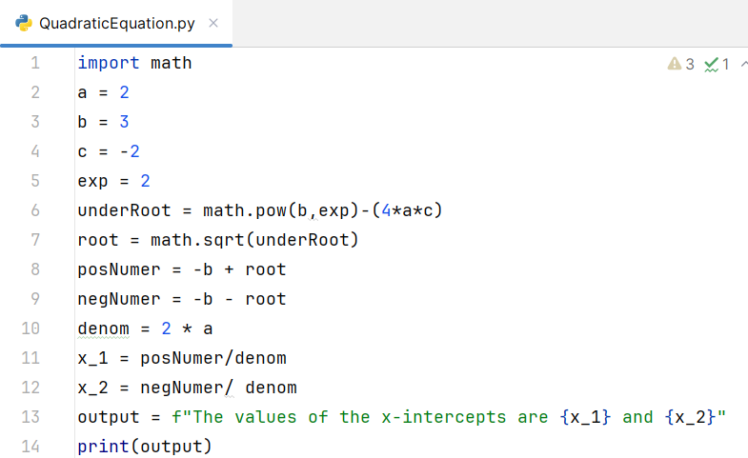
Since we used the known values a = 2, b =3, and c = -2 we know that correct answers
are 0.5 and -2. Hopefully, you get these results as well.

Slide 6
Homework
Modify, the program so that it prompts users for the values of ‘a’, ‘b’ and ‘c’.
Remember that input( ) only accepts Strings so you will have to cast the String variables into
something that will accommodate arithmetic.
Also, what about zero and negative numbers under the square root sign.
How could these be dealt with?
import math
a = float(input("What is the value of 'a' > "))
b = float(input("What is the value of 'b' > "))
c = float(input("What is the value of 'c' > "))
exp = 2
underRoot = math.pow(b,exp)-(4*a*c)
if underRoot > 0:
root = math.sqrt(underRoot)
posNumer = -b + root
negNumer = -b - root
denom = 2 * a
x_1 = posNumer/denom
x_2 = negNumer/ denom
output = f"The values of the x-intercepts are {x_1} and {x_2}"
print(output)
else:
output = "No intercepts"
print(output)

